Slide 1
CS4225/CS5425 Big Data Systems for Data Science
Tutorial 5: Graph and Test Practice

Slide 2
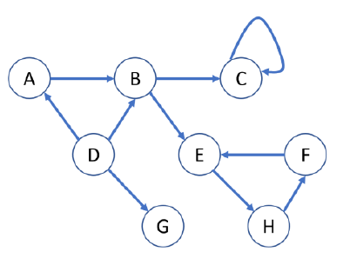
Question 1
Given the following graph:
How many dead ends are there in the graph? For each dead end (if any), please indicate the set of vertices forming the dead end.
How many spider traps are there in the graph? For each spider trap (if any), please indicate the set of vertices forming the spider trap.

Slide 3
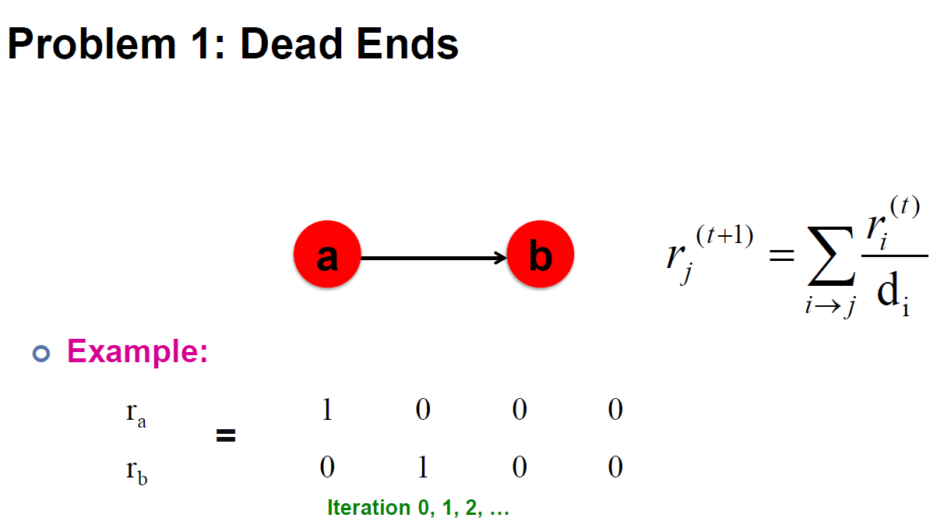
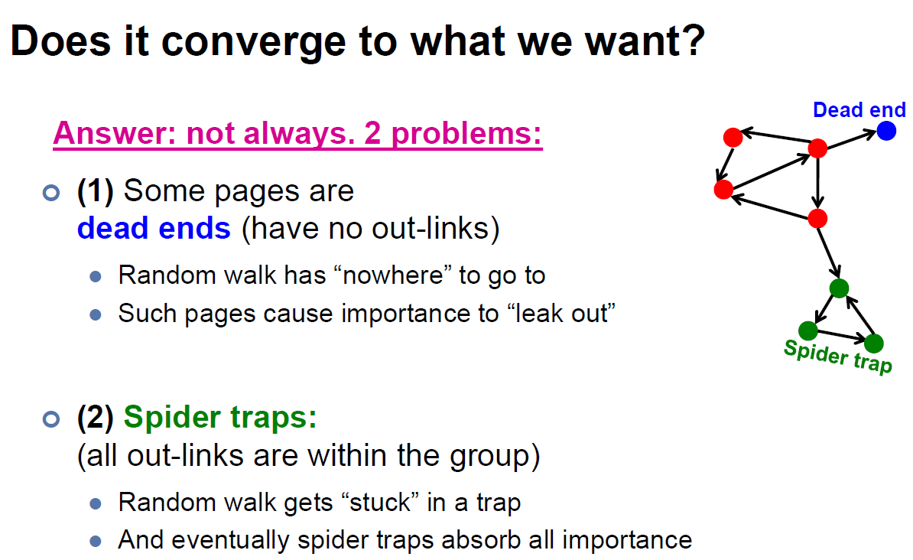
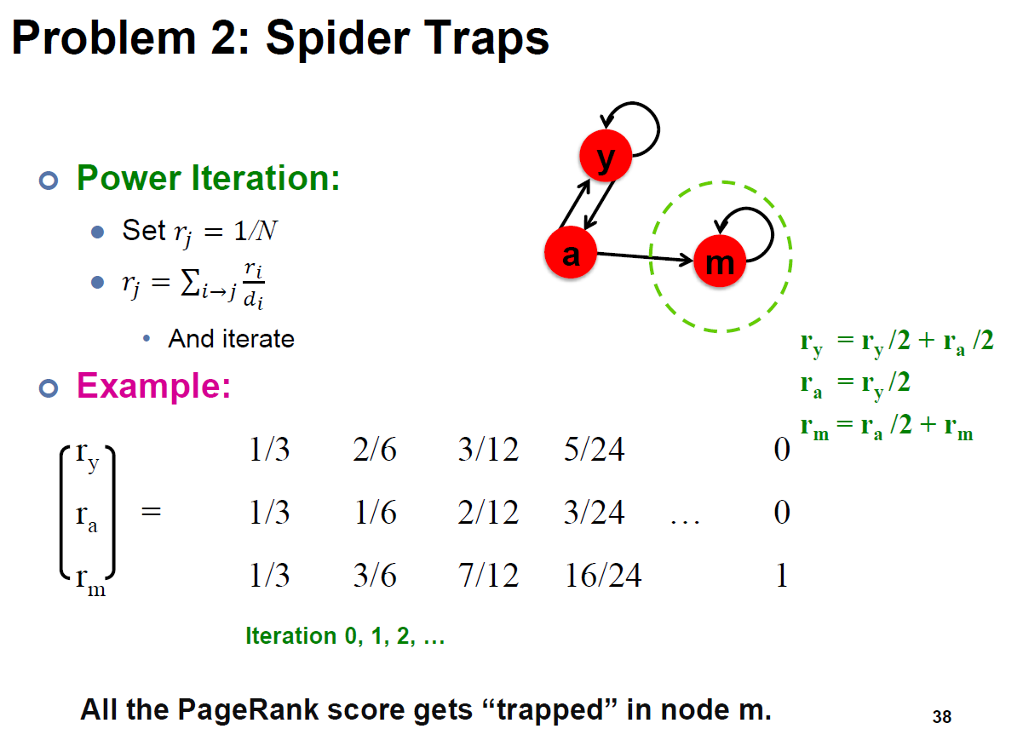
Answer 1
Lecture 9 Slide 37
Lecture 9 Slide 36
Lecture 9 Slide 38

Slide 4
Answer 1
Dead ends:
{G}
Spider traps:
{C},
{E, F, H},
{B, C, E, F, H},
{A, B, C, E, F, H}
Dead End

Slide 5
Question 2
True/False: In Topic-specific PageRank, random walker will teleport to any page with equal probability.
Answer 2
False. Random walker will only teleport to a topic-specific set of “relevant” pages.

Slide 6
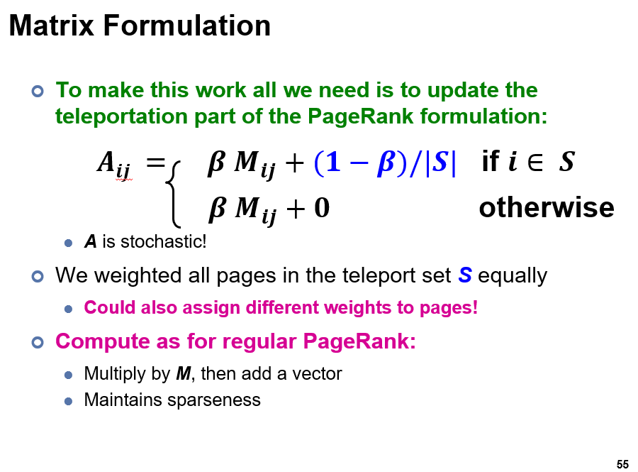
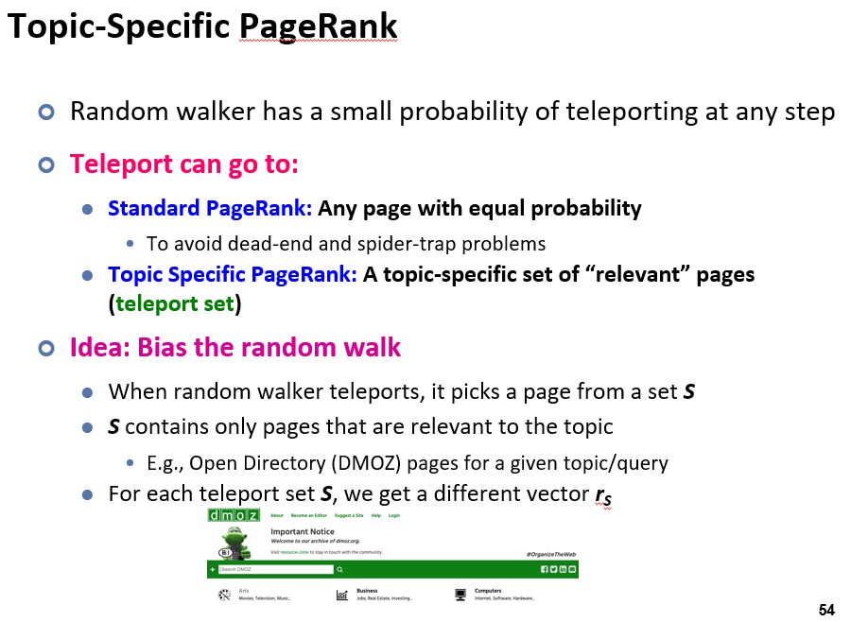
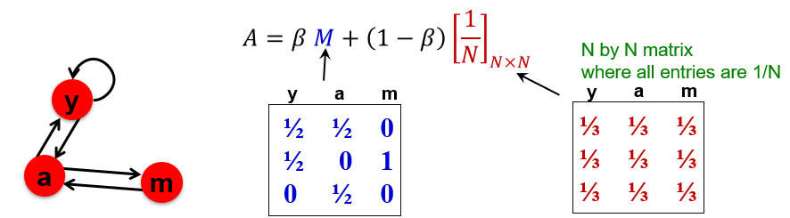
Lecture 9 Slide 55
Lecture 9 Slide 54
Lecture 9 Slide 49

Slide 7
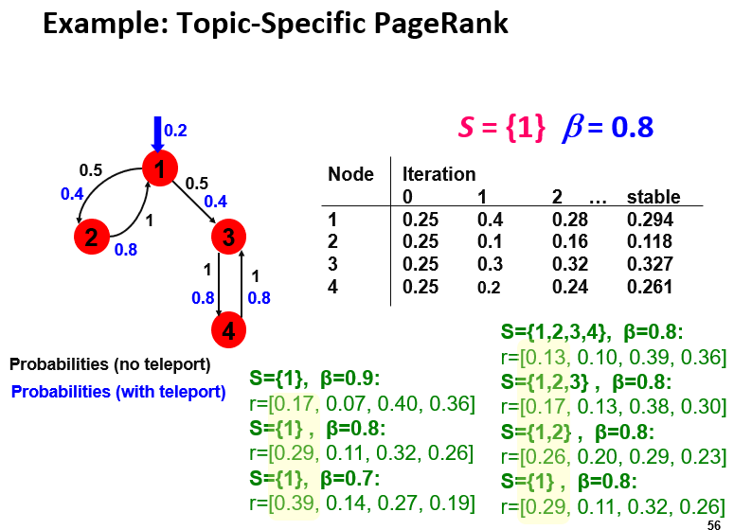
0.5
1
0.5
2
1
3
1
1
4
S = {1}, β = 0.8
A₁ = 0.8 (A₂) + (1 – 0.8) / 1
A₂ = 0.8 (0.5A₁) + 0
A₃ = 0.8 (0.5A₁ + A₄) + 0
A₄ = 0.8 (A₃) + 0
Lecture 9 Slide 56
0.2
1
0.4
0.4
2
3
0.8
0.8
0.8
4

Slide 8
A₁ = 0.8 (A₂) + (1 – 0.8) / 1
A₂ = 0.8 (0.5A₁) + 0
A₃ = 0.8 (0.5A₁ + A₄) + 0
A₄ = 0.8 (A₃) + 0
Iteration 0:
Set all nodes to 1 / 4 = 0.25
A₁ = A₂ = A₃ = A₄ = 0.25
Iteration 1:
A₁ = 0.8 (0.25) + (1 – 0.8) / 1 = 0.4
A₂ = 0.8 (0.5x0.25) + 0 = 0.1
A₃ = 0.8 (0.5x0.25 + 0.25) + 0 = 0.3
A₄ = 0.8 (0.25) + 0 = 0.2
Iteration 2:
A₁ = 0.8 (0.1) + (1 – 0.8) / 1 = 0.28
A₂ = 0.8 (0.5x0.4) + 0 = 0.16
A₃ = 0.8 (0.5x0.4 + 0.2) + 0 = 0.32
A₄ = 0.8 (0.3) + 0 = 0.24
Iteration … (4) :
A₁ = 0.294
A₂ = 0.118
A₃ = 0.327
A₄ = 0.261
Lecture 9 Slide 56

Slide 9
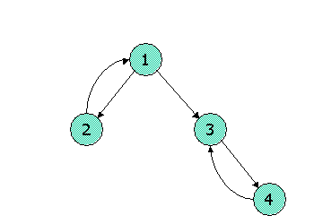
Question 3
Consider the following link topology.
Write down the Topic-Specific PageRank equations for the following link topology. Assume that pages selected for the teleport set are nodes 1 and 2 (where teleports go to either node with equal probability). Assume further that the teleport probability, (1 - β), is 0.3.

Slide 10
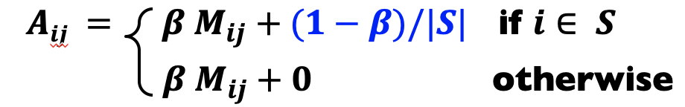
Answer 3
S = {1,2}, β = 0.7
Recall the topic sensitive pagerank (TSPR) equations:
Basically, the only difference here (compared to the non-topic sensitive case in the last 2 questions), is that the teleport terms are only distributed among the nodes in the teleport S, instead of being distributed over all nodes. Let r1, r2, r3, r3 denote the importance of the 4 nodes.

Slide 11
Answer 3
S = {1,2}, β = 0.7
r₁ = 0.7 (r₂) + (1 – 0.7) / 2
r₂ = 0.7 (r₁ / 2) + (1 – 0.7) / 2
r₃ = 0.7 (r₁ / 2 + r₄) + 0
r₄ = 0.7 (r₃) + 0
r1 = 0.7 r2 + 0.15
r2 = 0.35 r1 + 0.15
r3 = 0.35 r1 + 0.7 r4
r4 = 0.7 r3

Slide 12
Question 4
Show pseudocode for the compute() function for the PageRank with teleport (β = 0.85) over vertices algorithm in Pregel / Giraph. Set the initial PageRank value as 1/N (N is the number of vertices), Run 30 iterations and then stop. You can (if you choose) use the functions: getValue(), setValue(), getNumVertices(), getSuperStep(), getOutEdgeIterator().

Slide 13
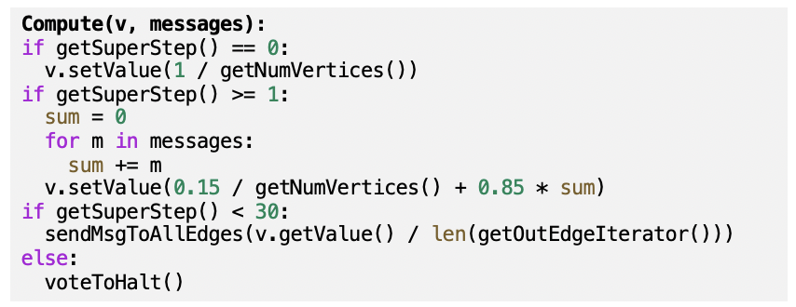
A₁ = 0.8 (A₂) + (1 – 0.8) / 1
A₂ = 0.8 (0.5A₁) + 0
A₃ = 0.8 (0.5A₁ + A₄) + 0
A₄ = 0.8 (A₃) + 0
Iteration 0:
Set all nodes to 1 / 4 = 0.25
A₁ = A₂ = A₃ = A₄ = 0.25
Iteration 1:
A₁ = 0.8 (0.25) + (1 – 0.8) / 1 = 0.4
A₂ = 0.8 (0.5x0.25) + 0 = 0.1
A₃ = 0.8 (0.5x0.25 + 0.25) + 0 = 0.3
A₄ = 0.8 (0.25) + 0 = 0.2
Iteration 2:
A₁ = 0.8 (0.1) + (1 – 0.8) / 1 = 0.28
A₂ = 0.8 (0.5x0.4) + 0 = 0.16
A₃ = 0.8 (0.5x0.4 + 0.2) + 0 = 0.32
A₄ = 0.8 (0.3) + 0 = 0.24
Iteration … (4) :
A₁ = 0.294
A₂ = 0.118
A₃ = 0.327
A₄ = 0.261
Writing pseudo code is fine; no worries about the syntax. E.g. len(x) or x.size() or “size of x” are all fine.

Slide 14
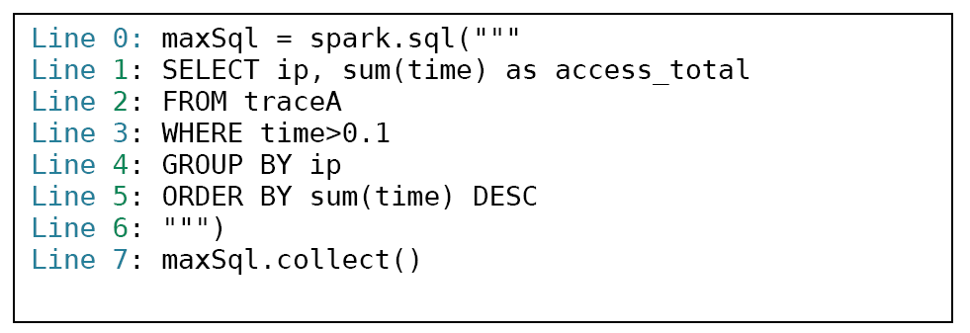
Question 5
On a certain large Spark cluster, Rose creates a data frame named traceA, and writes the shown program to process the trace. The traceA data frame keeps the logs, and each log entry represents the log information of one web page access, including various fields: ip, the IP address of the log entry and time, the amount of time of that access.
For the above codes, what are the potential performance bottlenecks? Please identify which lines cause the bottleneck and justify your answer.

Slide 15
Answer 5
Depending on whether the dataframe has been in the RAM, if not reading traceA (Line 1-3) may incur potential I/O cost
Depending on the size of data generated from Line 3, Line 4 & 5 can also be the bottleneck as both operations are wide transformation and thus require data shuffling through the network I/O.
If the grouped data after Line 4 is highly skewed (e.g. a super big size of data for certain ip address), Line 5 will have task straggler issue, i.e. certain tasks takes much longer time than the other tasks to complete.
Line 7 may return too many results. We can add LIMIT to the SQL query to limit the number of results.

